Slide 1

Hospital Project

Slide 2
Company Bio
About Us
DaTech Solutions is data driven technology company established in the year 2020. We provide our business clients with the best in-class services. Our services include:
Data collection and analysis
Business intelligence
Project Management and Consultancy
Software Development.
We value our clients and therefore guide them through each stage of their projects in a holistic manner whiles empowering them with the latest tools to stay ahead of the competition.
VISION
To be a world class data technology firm that enhances business decision making and productivity for businesses through data.
MISSION
To simplify the complexities of data collection and analysis processes for our business clients, enabling them to deliver on their core services.

Slide 3
Company Bio
Core Values
Innovation: we constantly strive to redefine the standard of excellence in everything we do. As a result, we are open to ideas that challenge the conventional views and drive innovation.
Integrity: we are honest, transparent and committed to doing what’s best for our customers and our company.
Quality: we take pride in providing high value services and products that meets expectations and requirements of our customers.
Results oriented: we focus on achieving results that add the best possible value for all our stakeholders, we are cost-conscious, we constantly improve significantly on service will deliver through power of teamwork.
Customer centric: our company exists to provide the best services for our customers. We make every decision and measure every outcome based on how well it serves our customers.
Teamwork: we aspire to build trust, strong relationship, encouragement and support for each other to build an organization where diversity is harnessed to work for the betterment of the common goals.

Slide 4
Our Team
HB
EU
BF
Humphrey Borketey
Project Manager , UX/UI Designer
Humphrey has worked in several multicultural environments spanning different industries, (Educational Technology, Logistics, Hospitality, and Telecommunications). He currently holds a Bachelor of Science in Information Technology and a CCNA. Humphrey loves to volunteer in his free time and travel - experiencing the various cultures of the world.
Efe Joyce Ughulu
Developer, UX/UI Designer
Efe has a strong educational background in Engineering which she obtained a B.Eng. in Chemical Engineering. She is a certified Project manager from project management academy, U.K, she is a certified Quality manager from Rahn Wesley Institute of management, U.K. she also has HSE 1,2,3 certification from the British International Safety Organization, U.K. She is the founder of Juwealth Digital Hub and the CTO at Mark of Success Nigeria Limited
Bommanin Franck A. Gnonteme
Developer, UX/UI Designer
Frank is a Finance Assistant for Africa Rescue and Assistant, Ivory Coast; and a Business Intelligence Trainee with Azubi Africa, Ghana. He currently holds an HND in Accounting and finance from Institute of Commercial Management, UK; and a Diploma in Project Management from International Business Management Institute, Germany. Franck is passionate about singing, writing and playing soccer.

Slide 5
Our Team
LT
ND
QA
Loni Tande Miriam Ebenye Data Scientist
Loni is an aspiring Big Data Engineer who is currently undergoing her undergraduate program in Computer Science at the University of Buea. She holds several Data Science certificates from LinkedIn Learning through Azubi Africa. Loni loves spending time with family and friends when she is free.
Nana Yirenkyiwaa Darko
Data Scientist
Nana-Yirenkyiwaa Juliana Darko, A Data Analysts with less than 1-year experience in the field. Has a BSc in Statistics and Computer Science. Juliana loves traveling, researching and a football lover
Queen Attipoe
Data Scientist
Queen is an engineer with a history of working in the telecommunications industry, analyzing performance trends and drawing insights from data to offer business solutions and improve customer experience. Holds a degree in Telecommunications Engineering. Loves watching movies, listening to music and surfing the internet in her free time.

Slide 6
Data Analysis Process
Business Understanding
Data Retrieval
Data Exploration
Problem Definition
The Government of Ghana is currently unable to strategically determine which locations to build hospitals in the country.
Objectives
Using hospital data provided by the Government of Ghana to perform data analysis to generate insights.
Create visualizations to present findings in a less complex format.
Based on findings, make recommendations to aid the government effectively build and position hospitals across the country.
Provide on-demand access to analysis, insights, and recommendations to the government by developing and publishing an app/website.
Hospital data containing the distinct types of hospitals and their respective locations was made available by government.
Variable Identification
Numerical: Longitude, latitude
Nominal: Region, district, towns, facility type, healthcare levels, facility name, ownership.
Analysing Dataset
Determined appropriate data types to be used.
Checked for null or blank data fields.
Checked for other anomalies (typographical errors, consistent naming conventions, etc.)
Relationships between variables.

Slide 7
Data Analysis Process Cont.
Data Cleaning
Questions asked/Hypotheses Generation
Correct data types for each column
Remove duplicates in data
Rename "type" column to "FacilityType"
Check "FacilityName" with psychiatric and correct "FacilityType" accordingly.
Group facilities into primary, secondary, and tertiary and name column “HealthCareLevel”
Delete rows with training institution, RCH, maternity, psychiatric as types
Facility grouping criteria
Primary: Clinic, Polyclinic, CHPS, Health Centre
Secondary: District, Regional, Municipal Hospital, Metropolitan Hospital, Psychiatric
Tertiary: Teaching Hospitals
Questions Asked
Are there health facilities in all regions?
Can different types of hospitals be grouped into subcategories?
Do all districts in a region have at least a health facility present?
Are the more government owned health facilities than private owned health facilities?
Are major districts more likely to have a greater number of health facilities?

Slide 8
Data Analysis Process Cont.
Questions asked/Hypotheses Generation Cont.
Hypothesis Generation
Null : There are equal number of privately owned health facilities and government owned health facilities in every region. FALSE
Alternate : There are more government health facilities across the country than private owned health facilities. TRUE
Null : There is an equal distribution of health facilities in both the Northern and Southern part of Ghana. FALSE
Alternate : There is an unequal distribution of health facilities in the Northern and Southern part of Ghana. TRUE
Null : Each district has at least access to primary healthcare facilities. TRUE
Alternate : Not all districts have access to primary healthcare facilities. FALSE
Null : Each region has access to one tertiary healthcare facility. FALSE
Alternate : Some regions have no access to tertiary healthcare facilities. TRUE
Null : There is at least one health facility in each district. TRUE
Alternate : Some districts have no health facilities. FALSE

Slide 9
Data Analysis Process Cont.
Analyze Data
Presentation
Productionalize Analysis
Data Analysis
Data was manipulated in several diverse ways using Microsoft excel and PowerBi.
Such as plotting data out, monitoring and drawing insights from the trends and charts generated.
Data Visualization
Created visual reports to show trends, and gain insights into the data provided. Reports were created for the country as a whole and the respective regions.
Data Visualization
Designed wireframe to conceptualize website to communicate findings.
Created sitemap to show website navigation

Slide 10
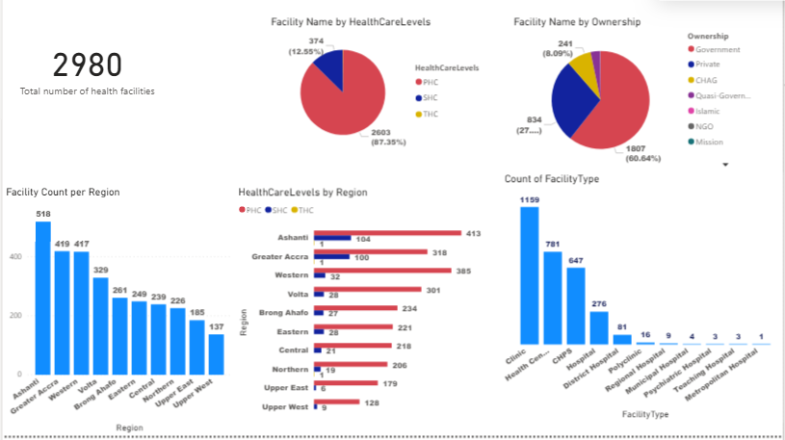
Data Visualization - Ghana

Slide 11
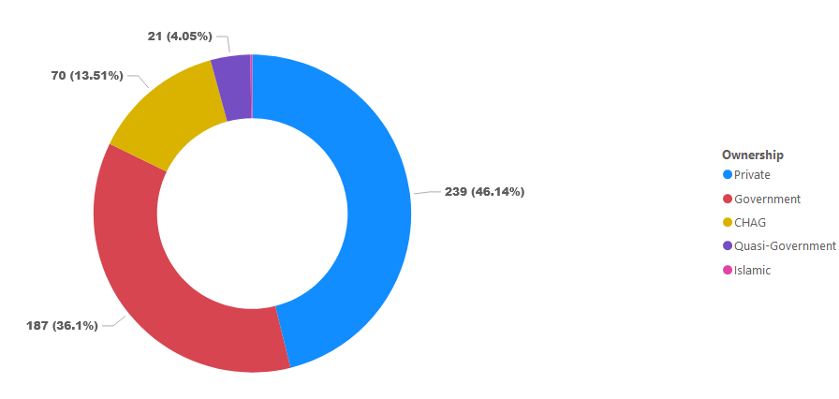
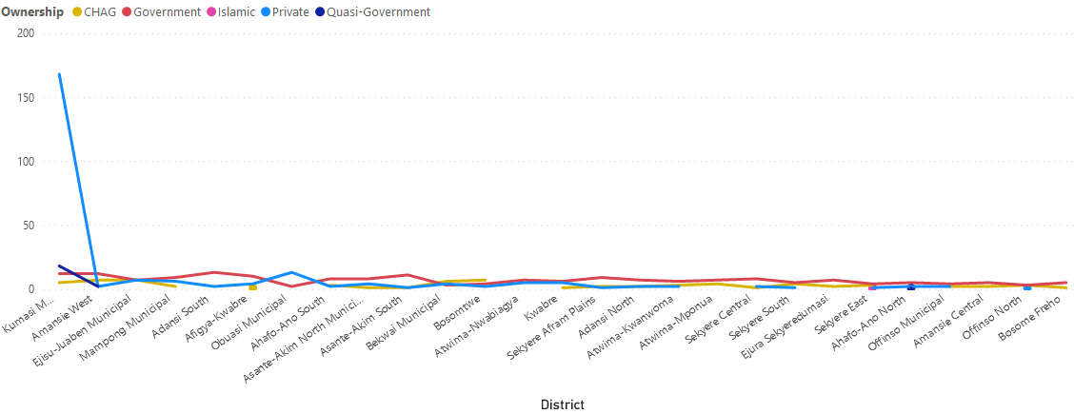
Data Visualization – Ashanti Region

Slide 12
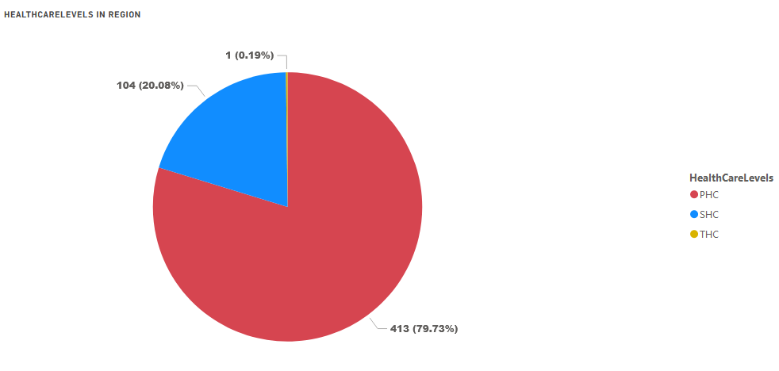
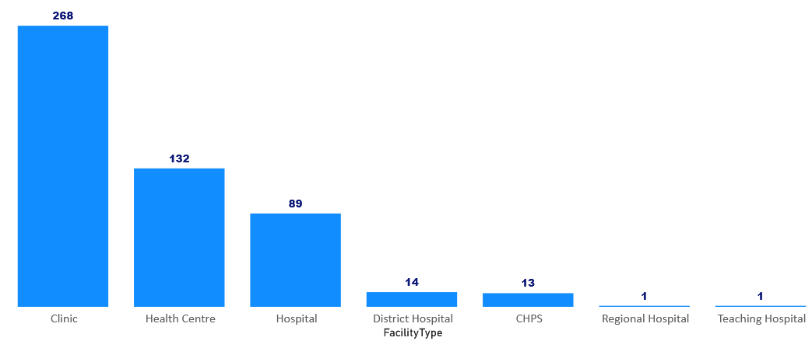
Data Visualization – Ashanti Region

Slide 13
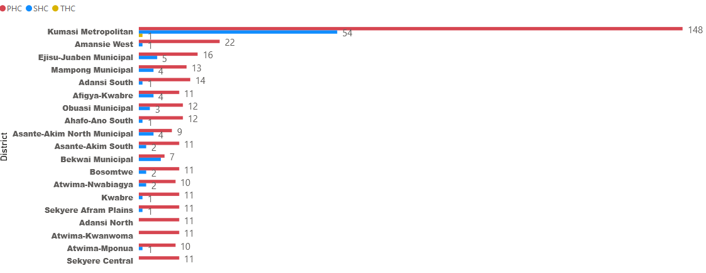
Data Visualization – Ashanti Region

Slide 14
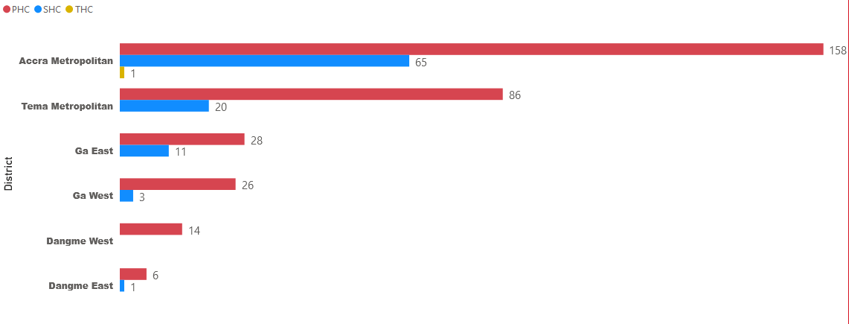
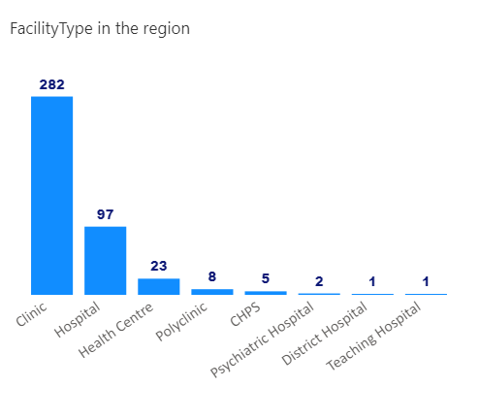
Data Visualization – Greater Accra

Slide 15
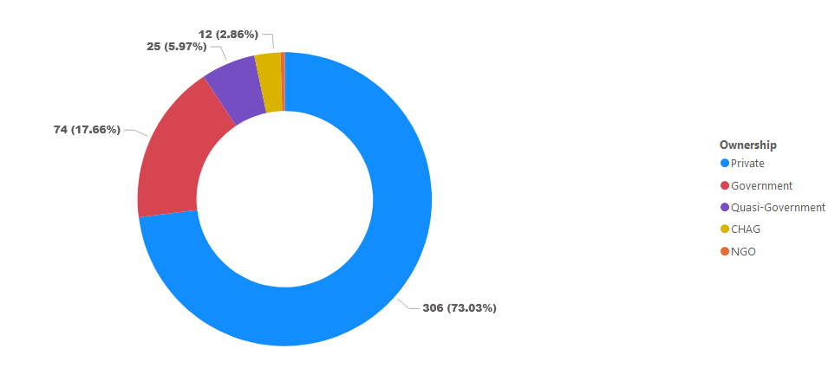
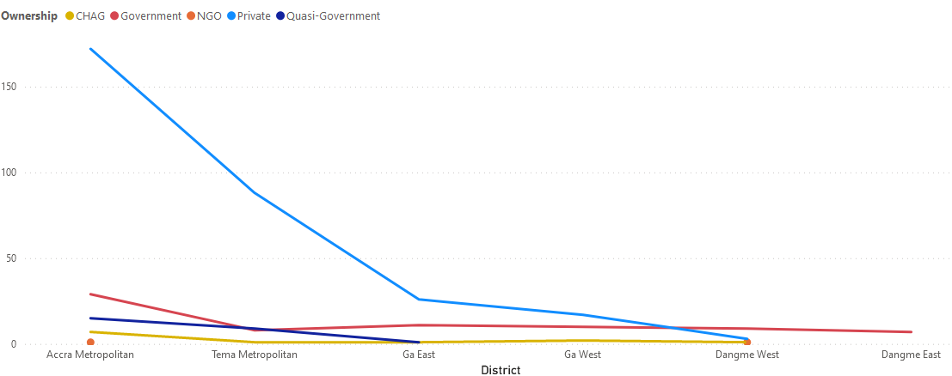
Data Visualization – Greater Accra

Slide 16
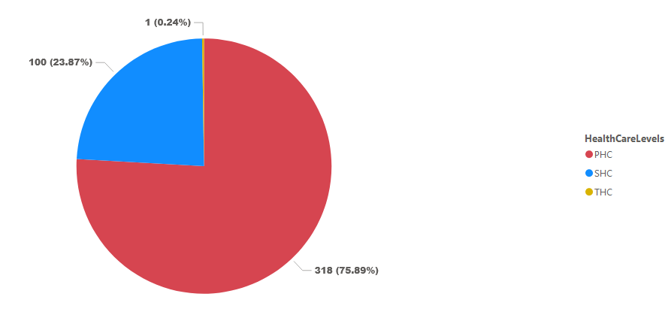
Data Visualization – Greater Accra

Slide 17
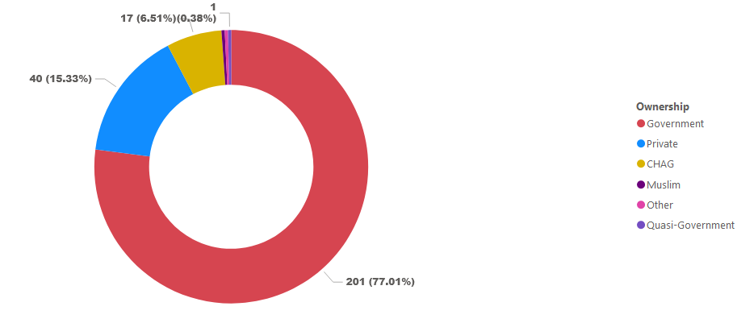
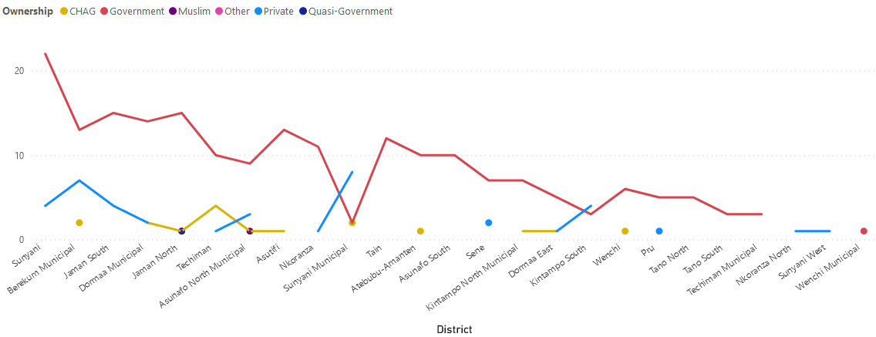
Data Visualization – Brong Ahafo

Slide 18
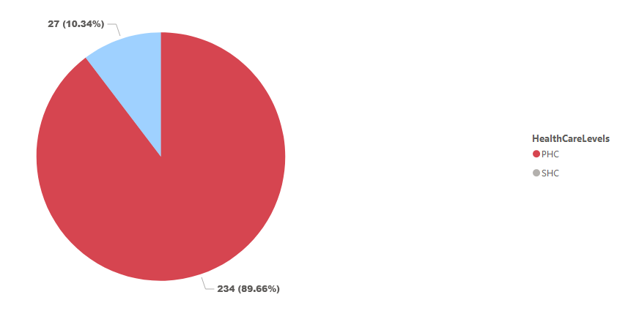
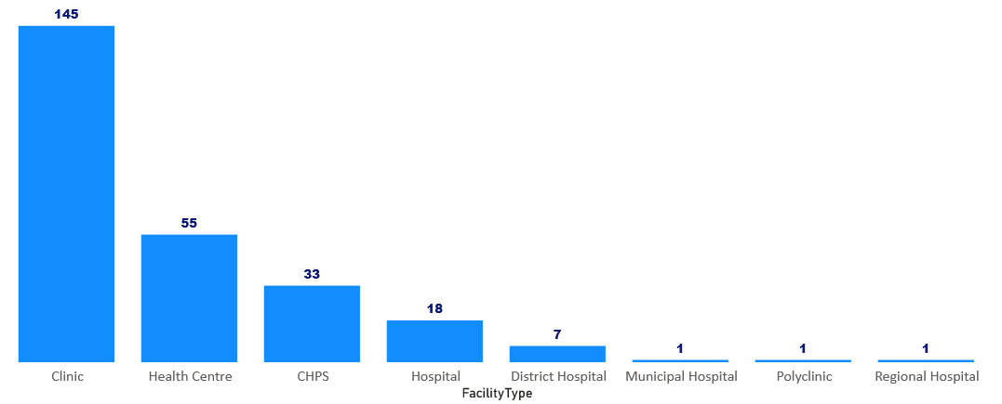
Data Visualization – Brong Ahafo

Slide 19
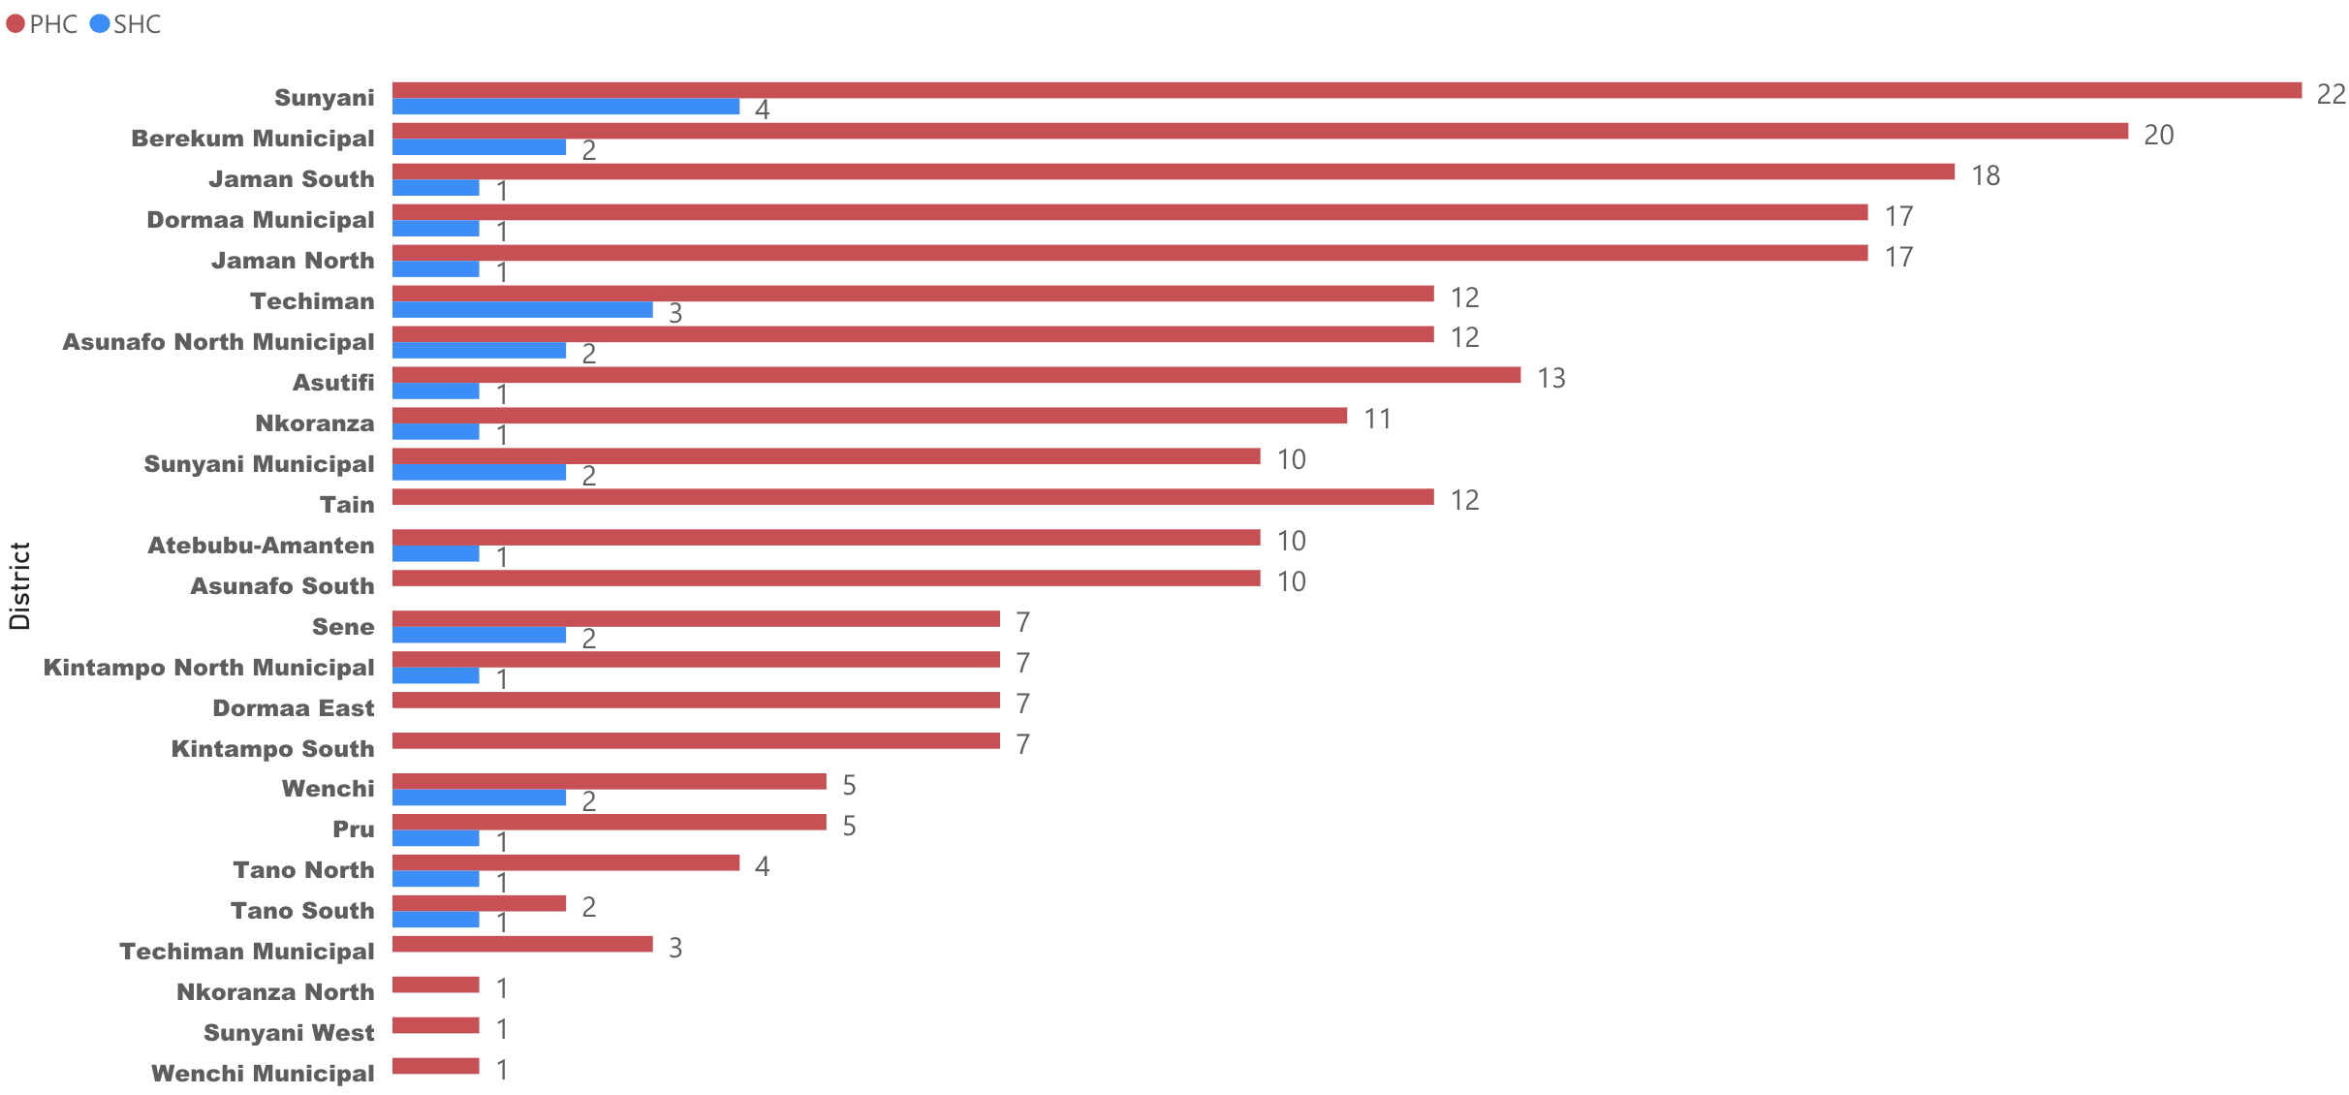
Data Visualization – Brong Ahafo

Slide 20
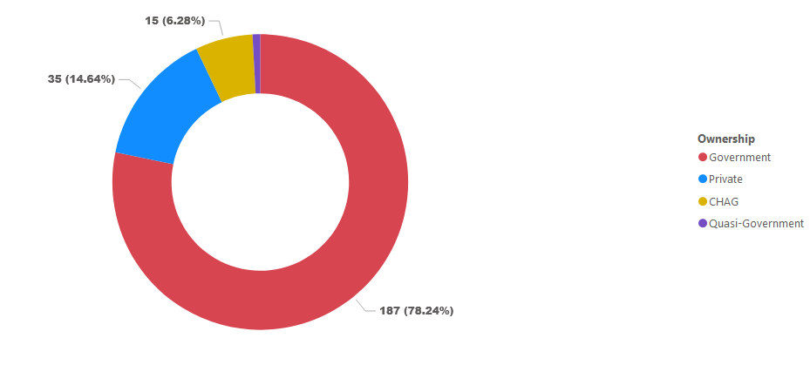
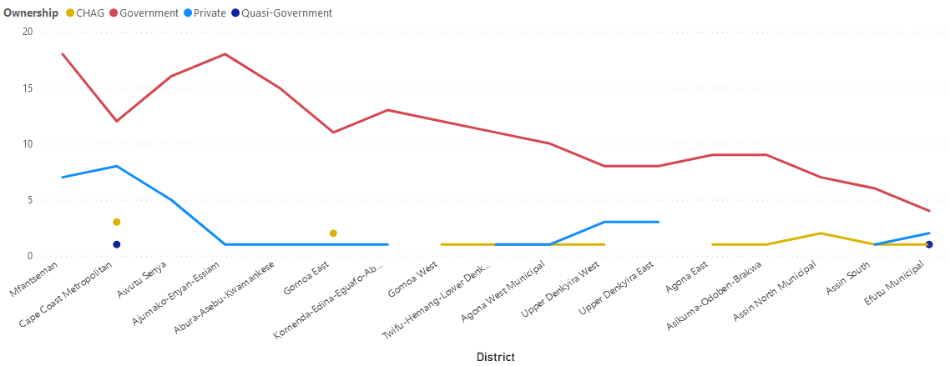
Data Visualization – Central Region

Slide 21
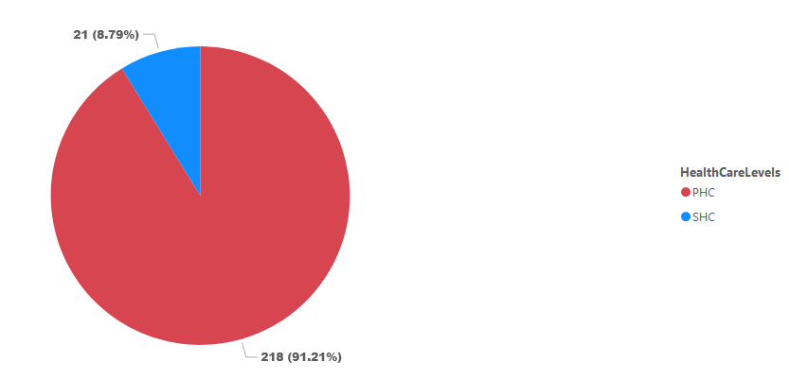
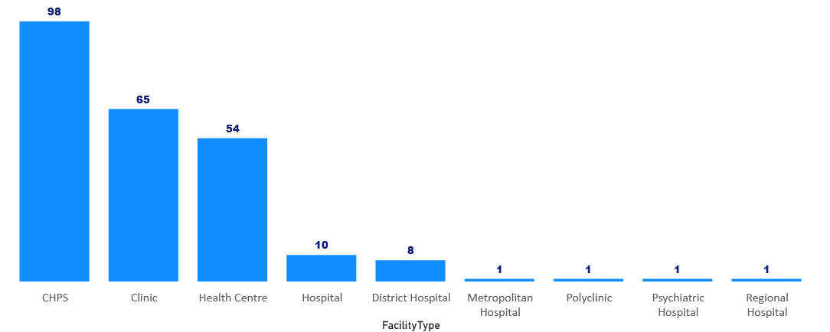
Data Visualization – Central Region

Slide 22
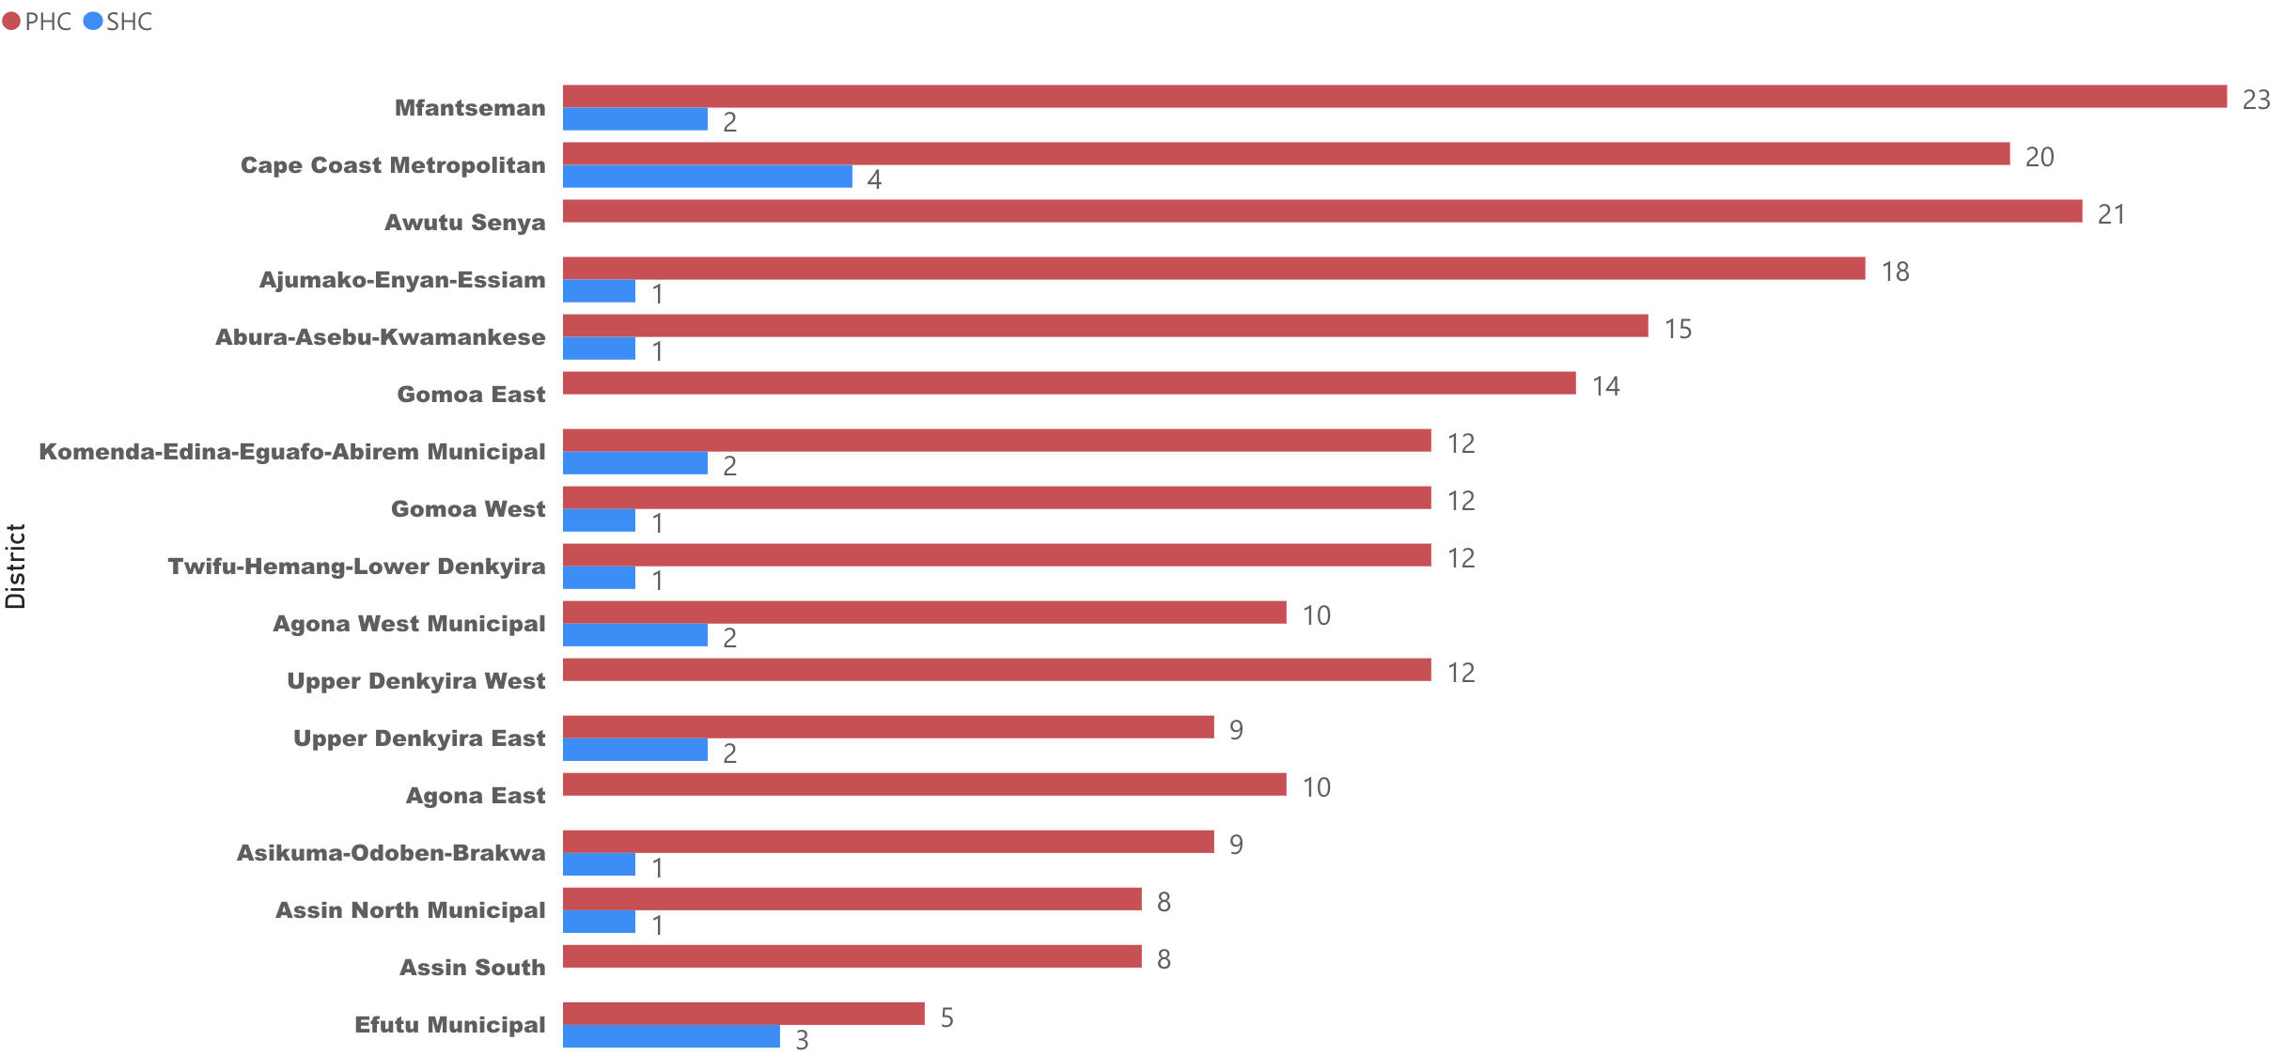
Data Visualization – Central Region

Slide 23
Recommendations
Only 3 regions, Greater Accra, Ashanti and the Northern, have access to tertiary healthcare facility. We recommend that at least one tertiary healthcare facility should be allocated in the other regions.
More healthcare facilities should be allocated in Ashanti and Greater Accra Region.
We recommend an increase in the number of secondary healthcare facilities in all regions but prioritizing Northern, Upper East and Upper West regions.
Primary healthcare facilities should be increased in districts with less than ten primary healthcare facilities.

